Slide 1
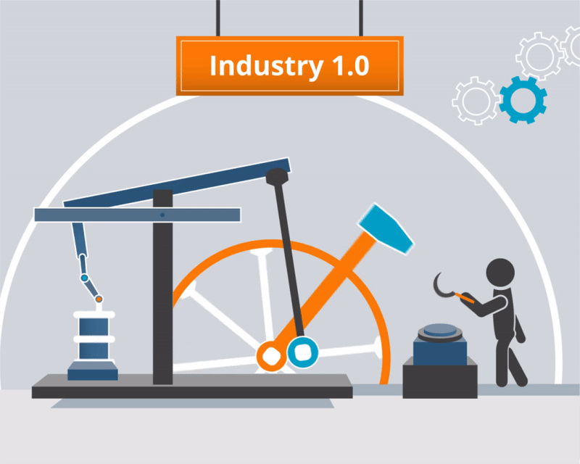

Slide 2


Slide 3
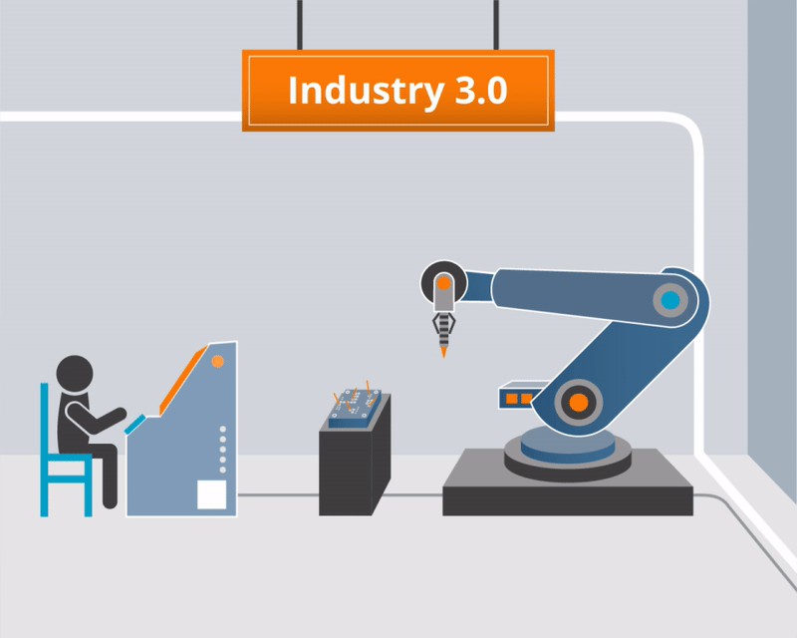

Slide 4
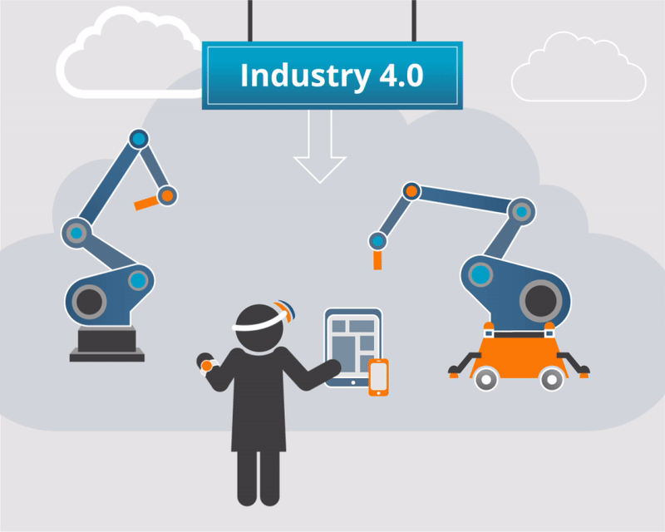

Slide 5








Slide 6
Global Opportunities for IT Jobs: An Analytical Perspective

Slide 7




Slide 9

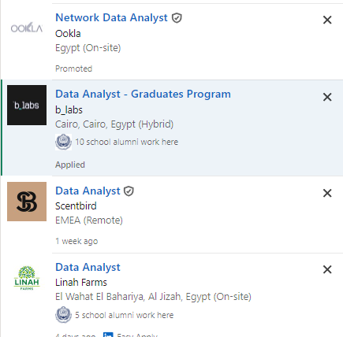
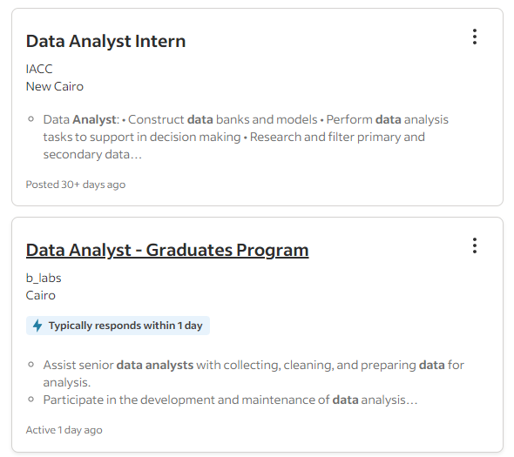
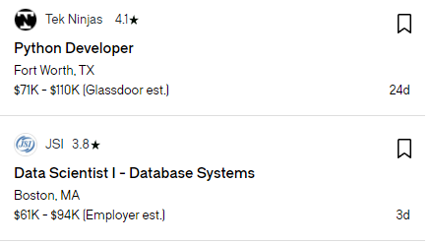

Slide 12
Location
United States
United Kingdom
India
United Arab Emirates
Canada
Languages
Python
Java
SQL
Scala
R

Slide 13
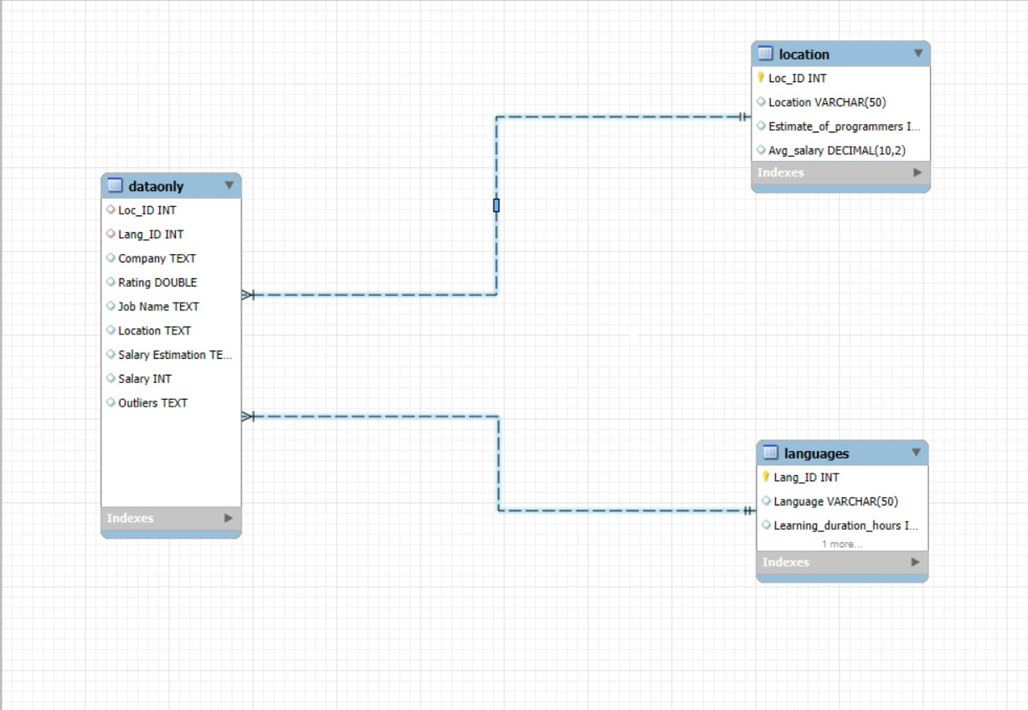

Slide 14


Slide 15
Developers are increasing by almost 1 million per year, and that's a good sign as the demand for IT jobs is still rising, so let's embark into the IT journey and have a fruitful life.

Slide 16


Sources & Deliverables
Average Annual Salaries:
USA: Bureau of Labor Statistics
UK: Office for National Statistics
India: National Sample Survey Office
UAE: Federal Competitiveness and Statistics Authority
Canada: Statistics Canada
Estimated Number of Programmers:
USA: Evans Data Corporation
UK: Stack Overflow
India: Evans Data Corporation
UAE: Numbeo
Canada: Canadian Information Processing Society
Deliverables Links:
Python Script
Excel Sheets
Power Bi
SQL Code

Slide 17


THANK YOU
Zeyad Aly
Abdelrahman Yousri
Abdullah Tarek
Mohamed Salah

